Slide 1
SUGAR SAVER
A Comprehensive Diabetes Management Solution

Slide 2
INTRODUCTION AND BACKGROUND
"SugarSaver: A Comprehensive Diabetes Management Solution" is a visionary project driven by a deep sense of social responsibility and the urgent need to address the diabetes epidemic affecting millions of people worldwide.
Diabetes is a chronic and pervasive health condition that affects individuals of all ages and backgrounds. According to the International Diabetes Federation (IDF), over 400 million people worldwide are living with diabetes, and this number is expected to rise dramatically in the coming years.
Diabetes can lead to a wide range of complications, including heart disease, kidney failure, blindness, and lower limb amputations, making it a significant global health challenge.

Slide 3
CONCEPTUAL DESIGN
Admin (AdminId*, Admin_Fname, Admin_Lname, Admin_Email)
Patient (PatientId*, Patient_FName, Patient_LName, Patient_Email, Patient_PhoneNo, Patient_Gender)
Doctor (DoctorId*, Doctor_FName, Doctor_LName, Doctor_Email, Doctor_PhoneNo, Doctor_Gender)
MedicalRecords (MRecordId*, PatientId, P_Age, PHeight, PWeight, LastHBA1CTestDate, HBA1CLevel, ExerciseFrequency, ExerciseType, SugarIntakeFrequency, OngoingMedications, HealthIssues, PreferredMeal)
DietPlan (DP_id*, PatientId , DietPlan, HBA1CLevel)
AdminLogin (AdminLoginId*, UserName, UPassword)
PatientLogin (PatientLoginId*, UserName, UPassword)
DoctorLogin (DoctorLoginId*, UserName, UPassword)

Slide 4
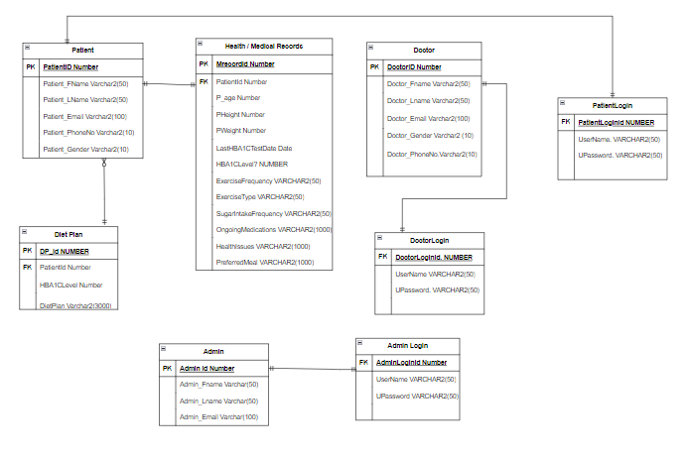
ENTITY RELATIONSHIP DIAGRAM

Slide 5
APPLICATION FUNCTIONS
The Sugar Saver system caters to three distinct user roles: Admini, Doctors, and Patients, each having individual login credentials.
User Authentication and Password Reset:
Every user type (Admin, Doctor, Patient) has the ability to reset their password and establish a new one in case of a forgotten password.
Admin Privileges:
Upon logging in, the administrator gains access to doctor and patient records, with permission to remove these records as needed.
Doctor Access and Functions:
Doctors possess the capability to view and analyze patient medical information and records, as well as recommend personalized diet plans based on the patient's condition.
Patient Interactions:
Patients have the authority to upload and update their medical information within the system. Additionally, they can access the diet plans suggested by doctors .
The system architecture supports a Diabetes Management platform where administrators oversee all records, doctors provide medical insights and dietary guidance, and patients actively manage their health by updating their medical data and accessing relevant information tailored to their condition

Slide 6
DATABASE OPERATIONS
Admin Operations:
DELETE: Admins can remove doctor or patient records and other administrative information as necessary.
SELECT: Administrators have full access to view and retrieve doctor and patient records, as well as other relevant administrative data stored in the system.

Slide 7
DATABASE OPERATIONS
Doctor Operations:
INSERT: Doctors can't directly insert records, but they can update patient medical details, suggest diet plans, and add medical insights to existing records.
UPDATE: Doctors are able to update patient medical information, modify suggested diet plans, and provide updated medical insights for specific patients.
SELECT: Doctors can view patient medical details, retrieve records for analysis, access diet plans, and review FAQ sections.

Slide 8
DATABASE OPERATIONS
Patient Operations:
INSERT: Patients can upload and update their medical details.
UPDATE: Patients can modify their own medical information and update their health-related data as needed.
SELECT: Patients can access their medical details, view suggested diet plans provided by doctors, and read FAQ sections related to diabetes management.

Slide 9
SUGAR SAVER DEMO

Slide 10
THANK YOU
-Sahil Raorane sraorane@hawk.iit.edu
-Anushka Sonar asonar@hawk.iit.edu
-Dhanya Sangoli dsangolli@hawk.iit.edu
-Yashraj Diwate ydiwate@hawk.iit.edu
-Pratik Bhojkar Pbhojkar@haw.iit.edu
-Aniket Singh asingh171@hawk.iit.edu

